Slide 1
Winter Aspen 2023
Dark SRF pathfinder result and beyond
Zhen Liu
University Minnesota
03/30/2023
Mainly based upon A. Romanenko et al, 2301.11512

Slide 2

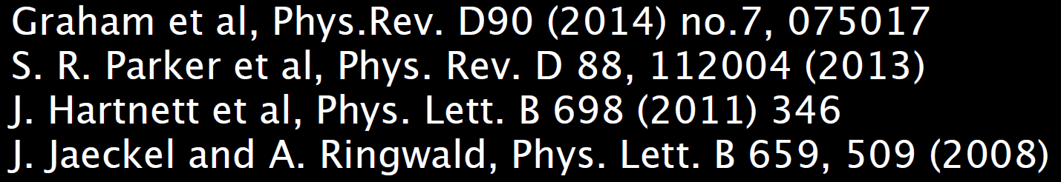
Intro
Kinematically mixed dark photons are well-motivated.
There are many past, ongoing and future searches.
Today, I report the pathfinder results of one such efforts and discuss its future.

Slide 3
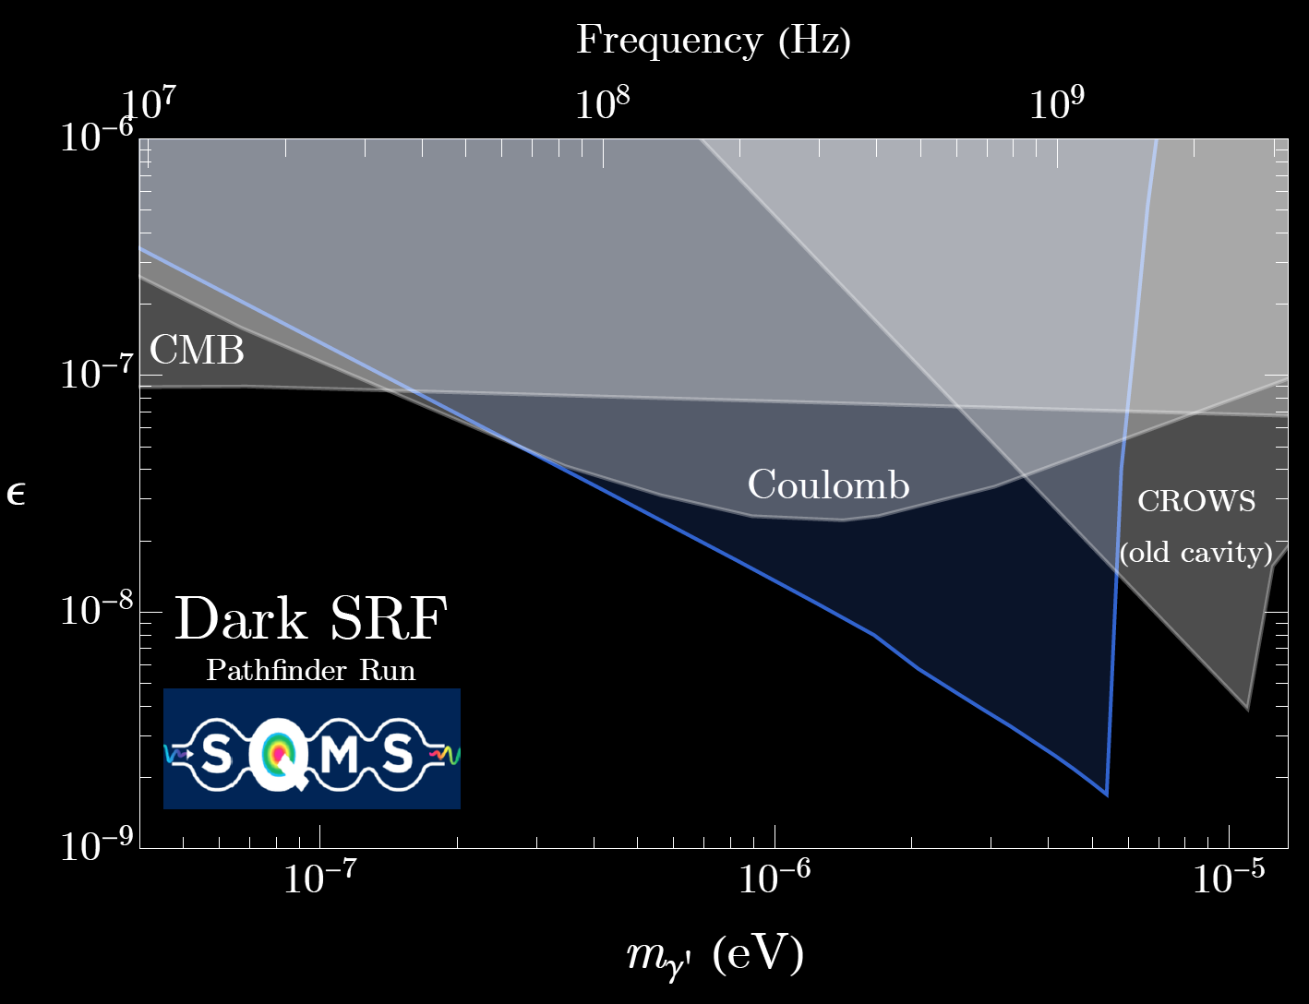


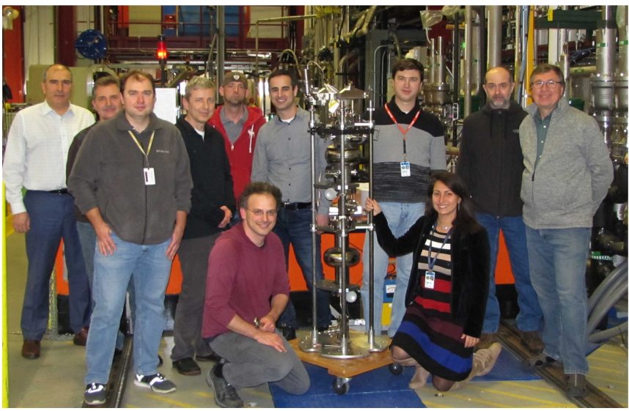
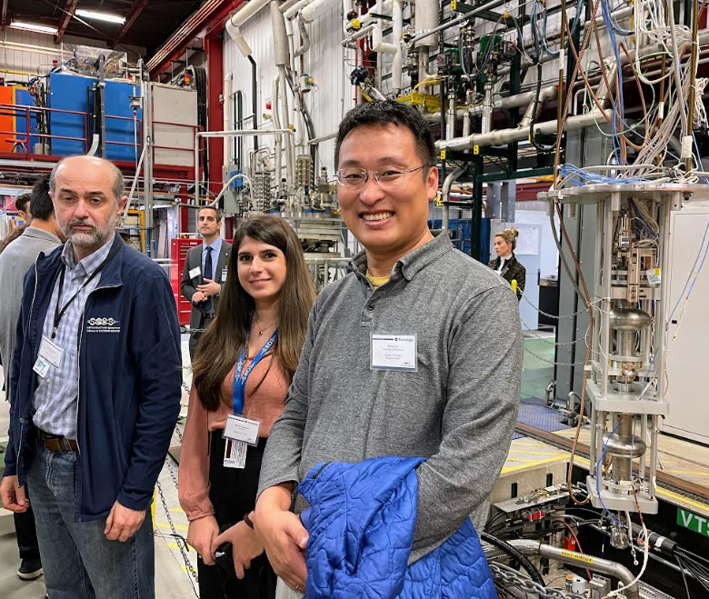
Pathfinder result
Our pathfinder run results already explore new territory!
Work was performed at Fermilab and University of Minnesota
Notes:
We did it! Mu distortion, (kinetic equilibrium; out of chemical equilibrium→ not allowed to modify photon number. CMB photon imprint. ) (Landau-level crossing.) (). DOE.

Slide 4
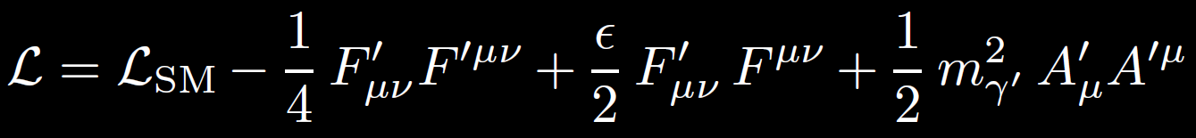


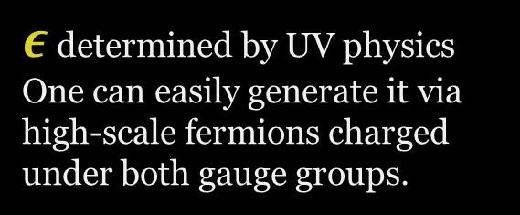
A generic light hidden photon
Our
Electromagnetism
Hidden Electromagnetism
$ε$ determined by UV physics
One can easily generate it via high-scale fermions charged under both gauge groups.
See the discussion on the $ε$ size, e.g., Gherghetta, Kersten, Olive, Pospelov, 1909.00696

Slide 5
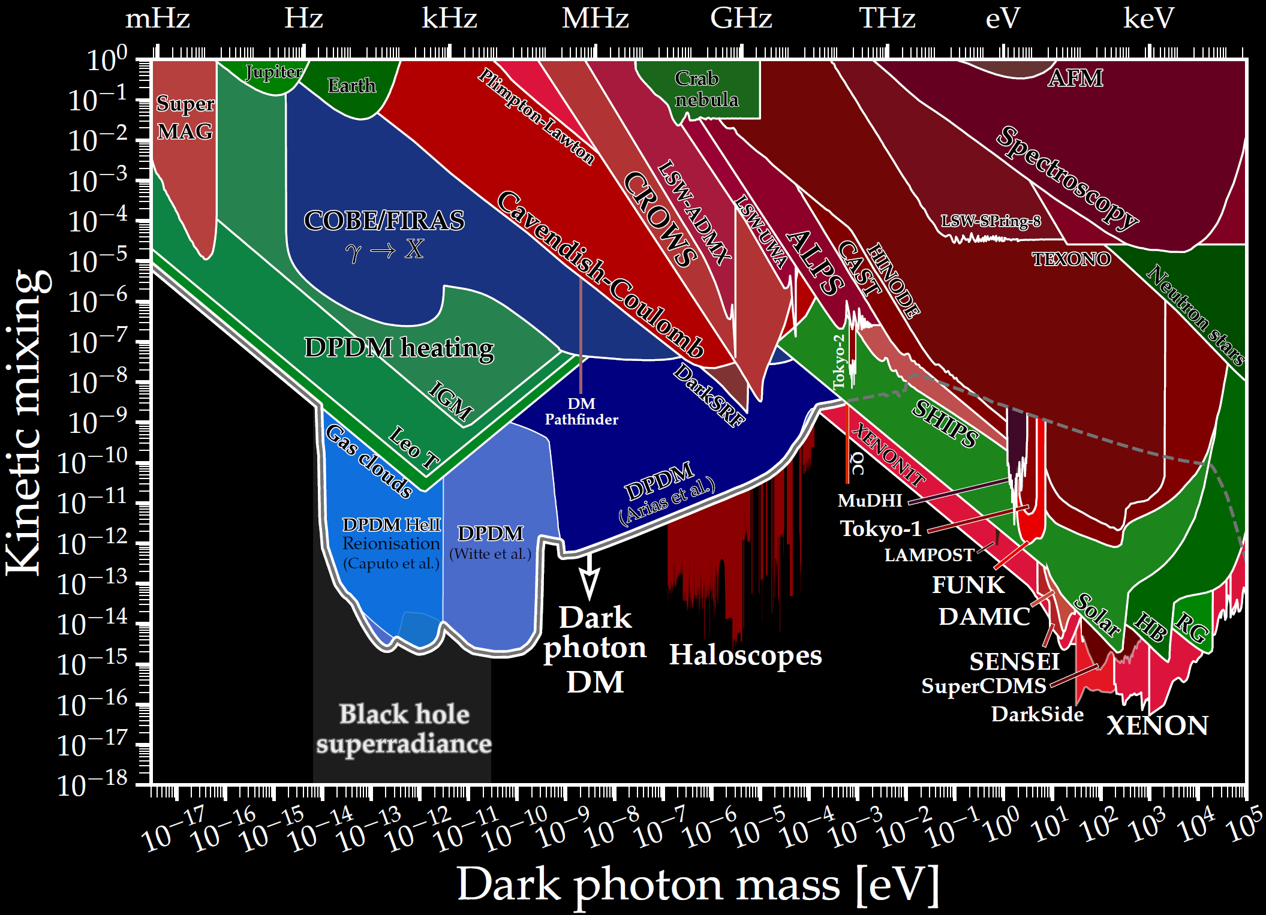

An Active Program
https://cajohare.github.io/AxionLimits/docs/dp.html C. O’Hara

Slide 6
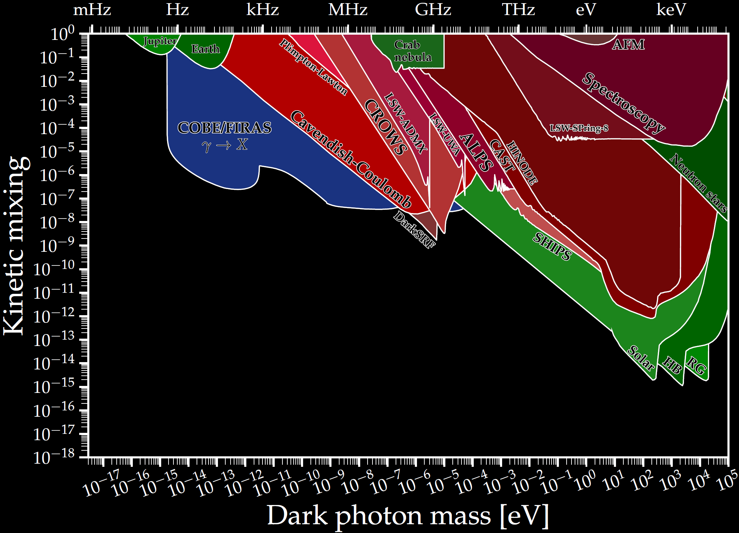
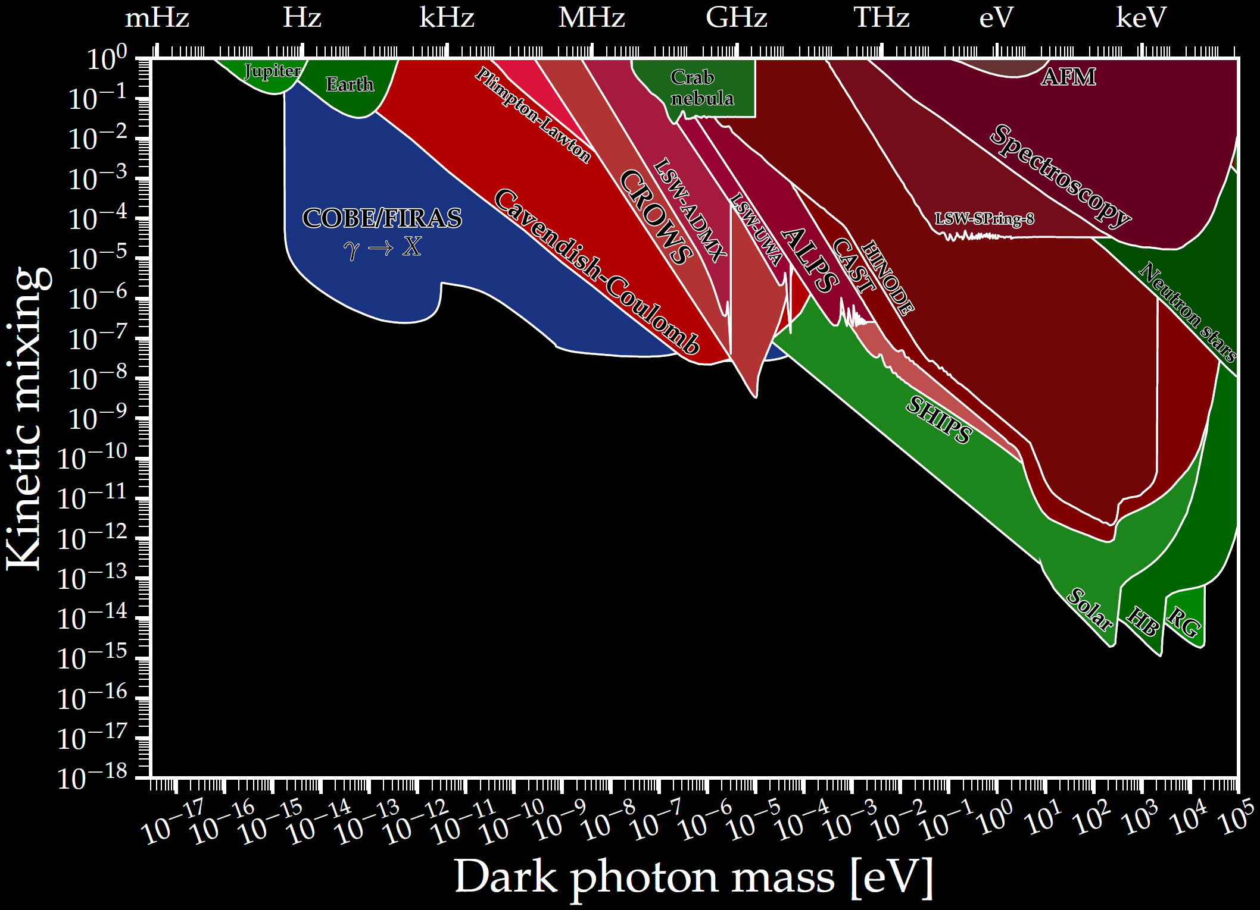
An active program: much less known when not dark matter

Slide 7
What is Dark SRF?

Slide 8
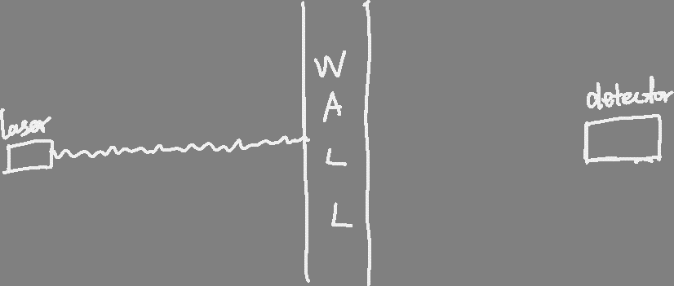
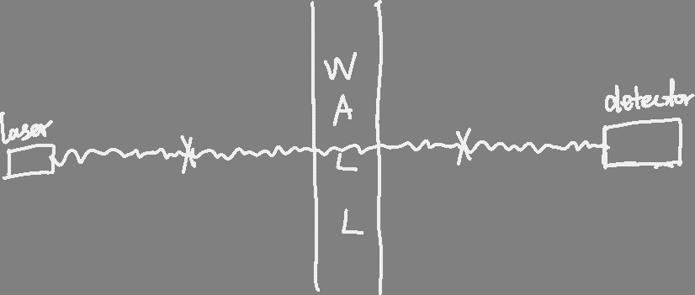


Light Shining through Wall (LSW)
$$ε$$
$$ε$$

Slide 9
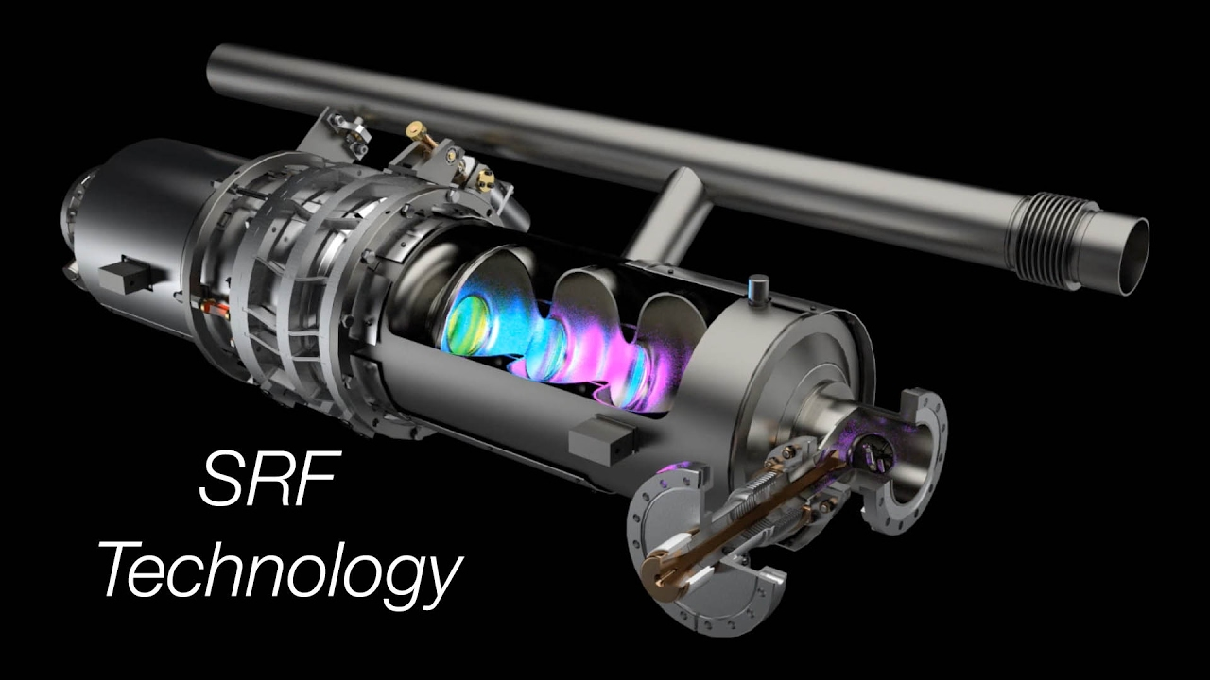
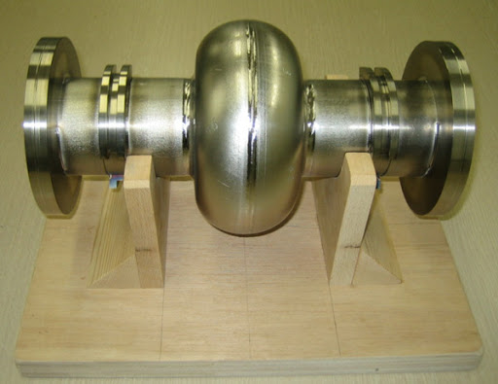
We have the best SRF for High Energy Accelerators
Superconducting RF Cavities:
Large fields
High Quality
Superconducting Radio Frequency (SRF) cavity

Slide 10

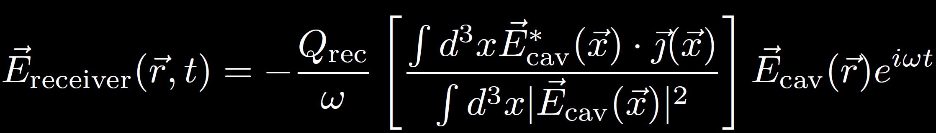
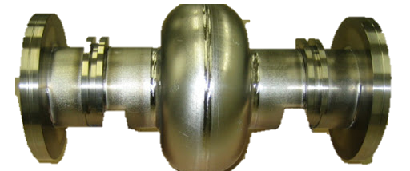

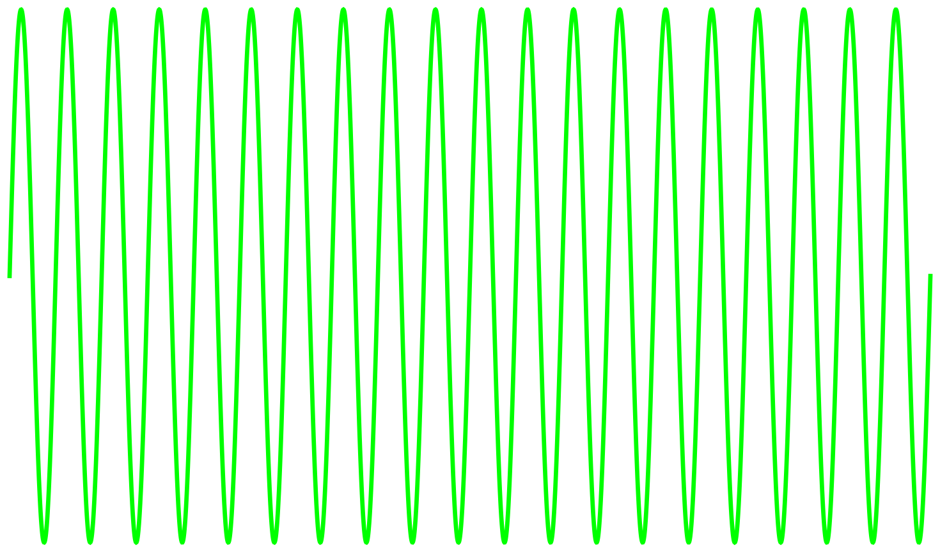

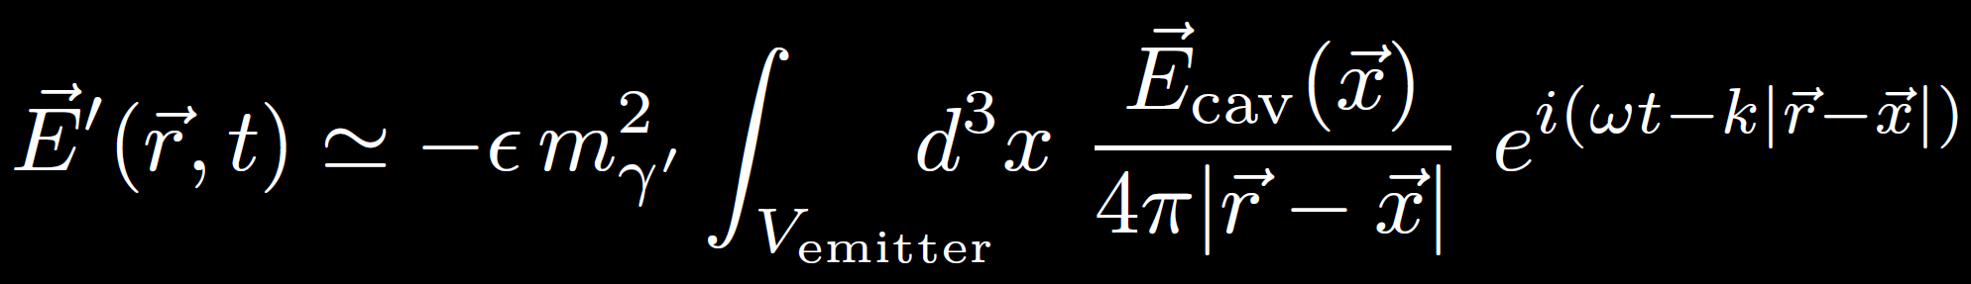
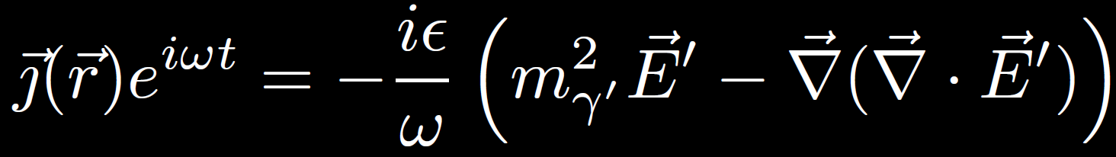


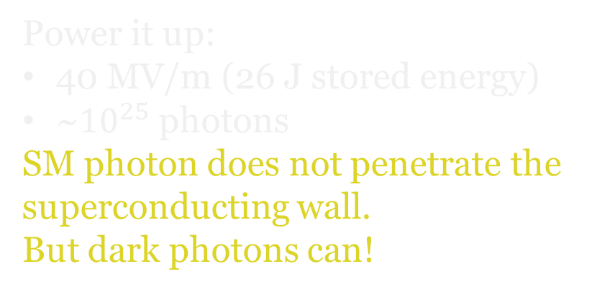

SRF for Dark Photon
$$ε$$
$$ε$$
Power it up:
40 MV/m (26 J stored energy)
~${10}^{25}$ photons
SM photon does not penetrate the superconducting wall.
But dark photons can!
Isolated receiver
•High Q of ${10}^{10}$ (accumulate tiny signal power)

Slide 11
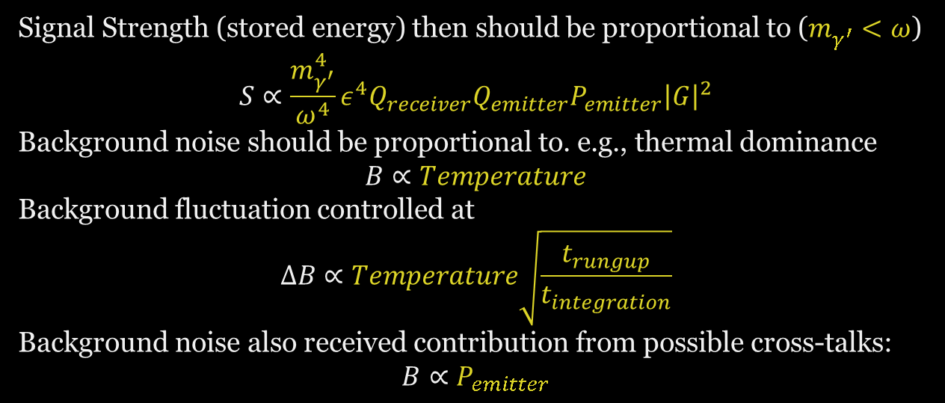


SRF for Dark Photon: naïve parametrics
$$ε$$
$$ε$$
Signal Strength (stored energy) then should be proportional to ($m_{γ^{′}}^{ }<ω$)
$$S∝\frac{m_{γ^{′}}^{4}}{ω^{4}}ε^{4}Q_{receiver}Q_{emitter}P_{emitter}{\left|G\right|}^{2}$$
Background noise should be proportional to. e.g., thermal dominance
$$B∝Temperature$$
Background fluctuation controlled at
$$ΔB∝Temperature\sqrt{\frac{t_{rungup}}{t_{integration}}}$$
Background noise also received contribution from possible cross-talks:
$$B∝P_{emitter}$$
$$t_{rungup}=\frac{Q}{ω}\sim 1 sec$$

Slide 12
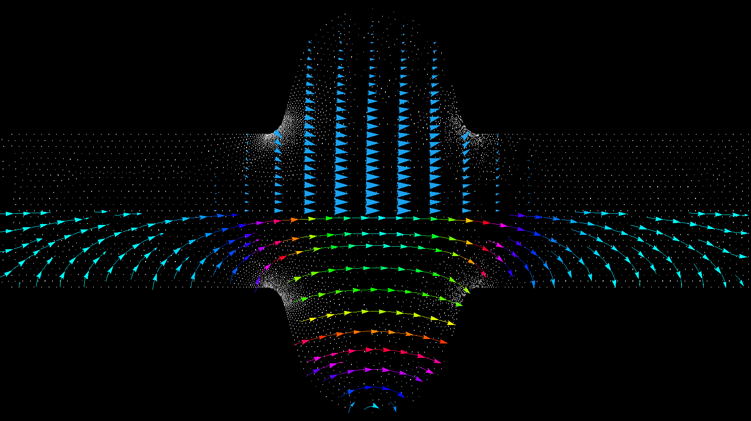
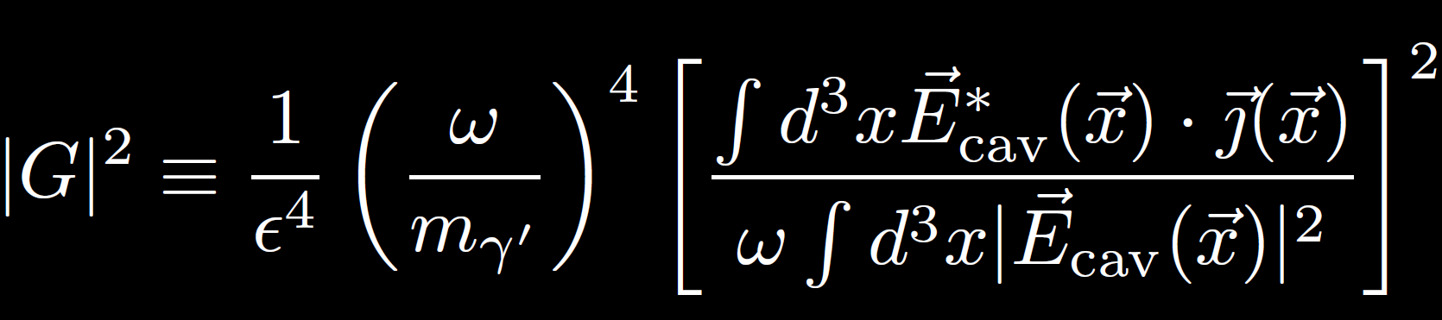
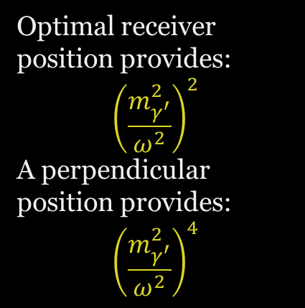
Real Cavity Configuration
Real geometry: high gradience
There exists a optimal receiver direction: longitudinal dominance
(special feature of massive particle), P. Graham, J. Mardon, S. Rajendran, Y. Zhao, 14’
E field strength
Optimal receiver position provides:
$${\left(\frac{m_{γ^{′}}^{2}}{ω^{2}}\right)}^{2}$$
A perpendicular position provides:
$${\left(\frac{m_{γ^{′}}^{2}}{ω^{2}}\right)}^{4}$$
E Gradient Flow
Hidden Photon field highly oscillatory (numerical stability)

Slide 13
Dark SRF Pathfinder Runs

Slide 14
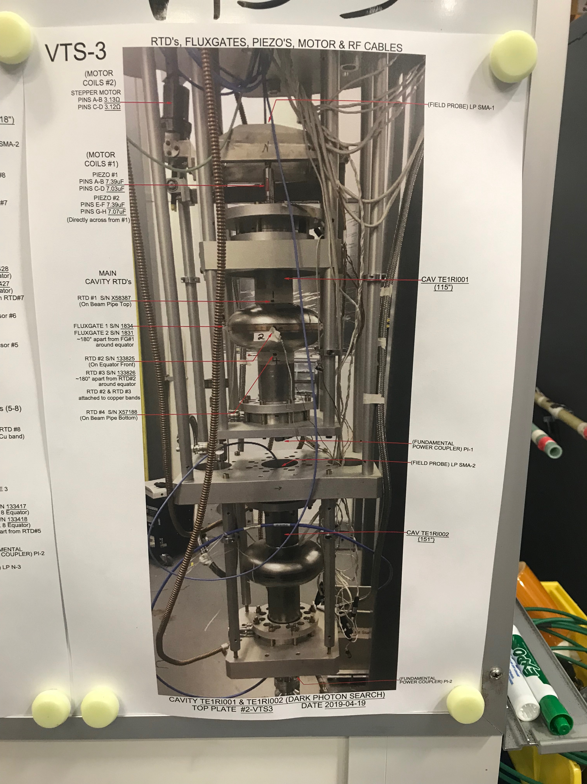
Pathfinder run(s) summary
It works!
Design
Tuner operation
Microwave scheme for matching the frequencies
Actual data – first acquisition

Slide 15
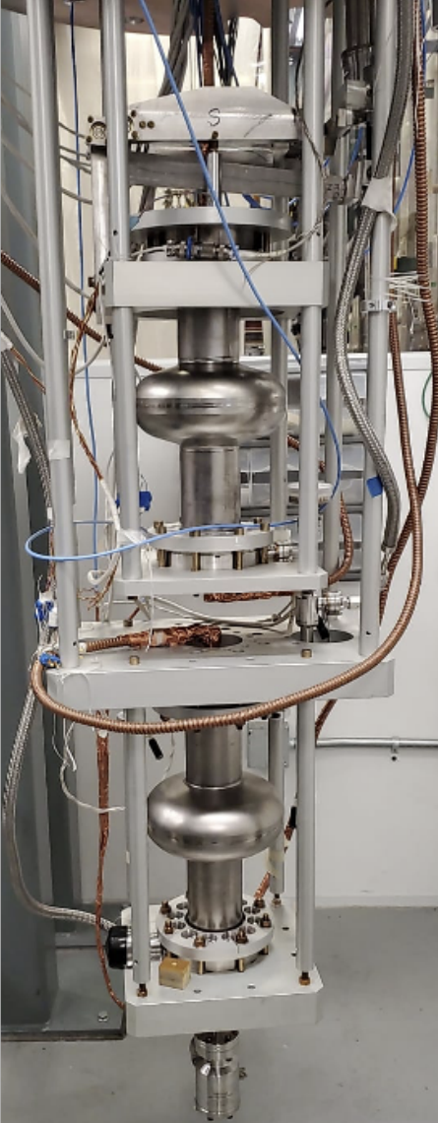
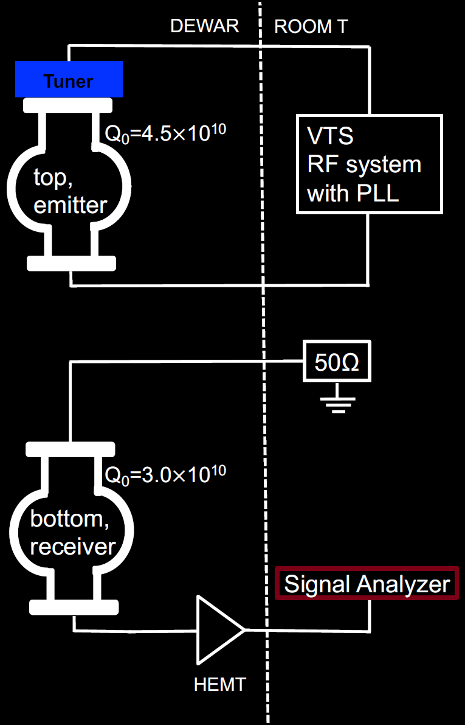
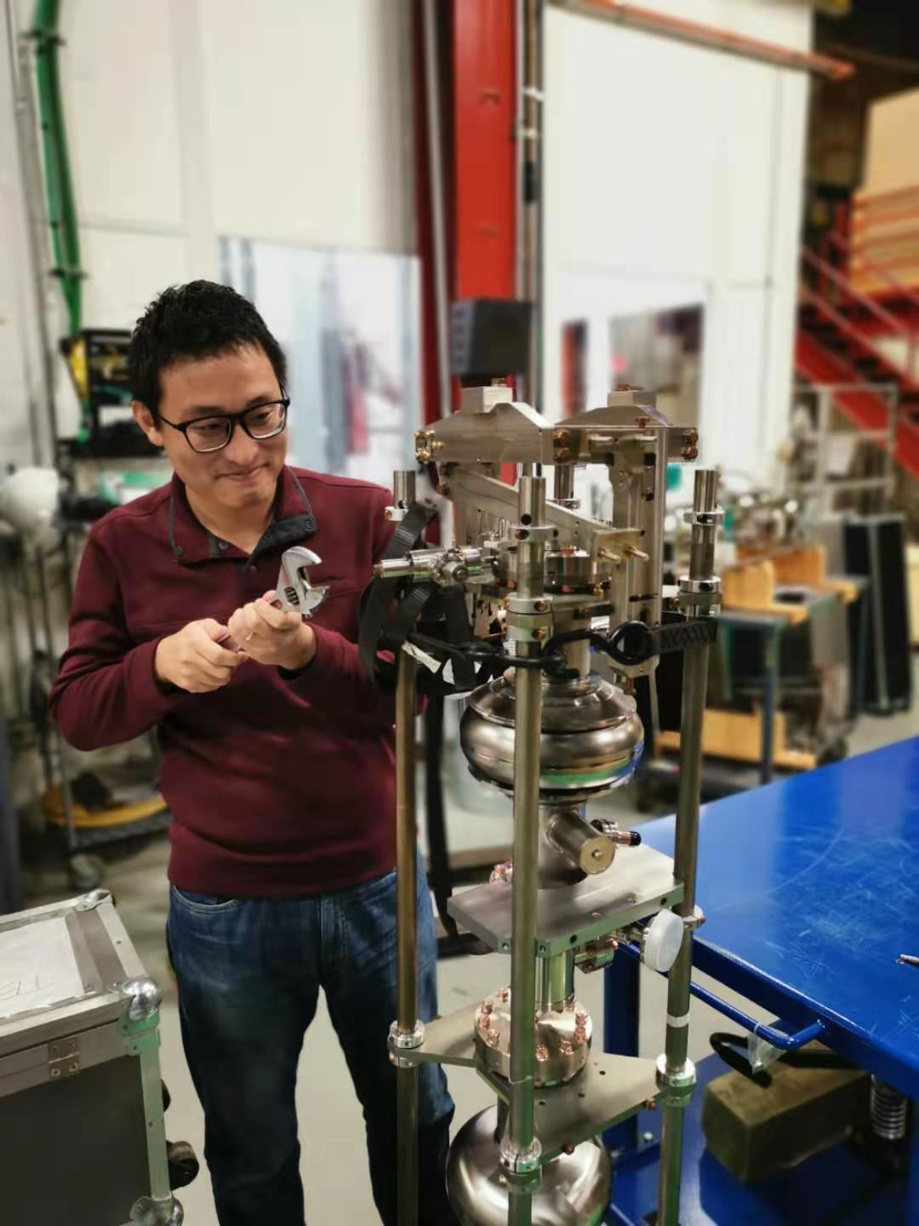

Slide 16
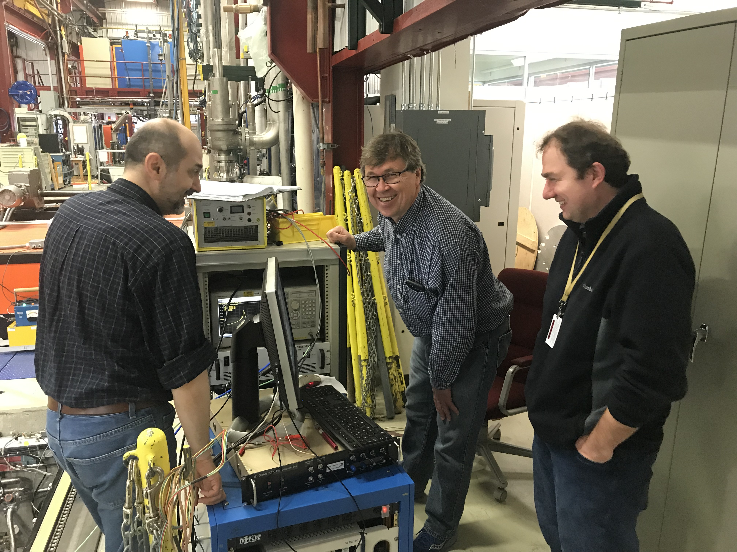
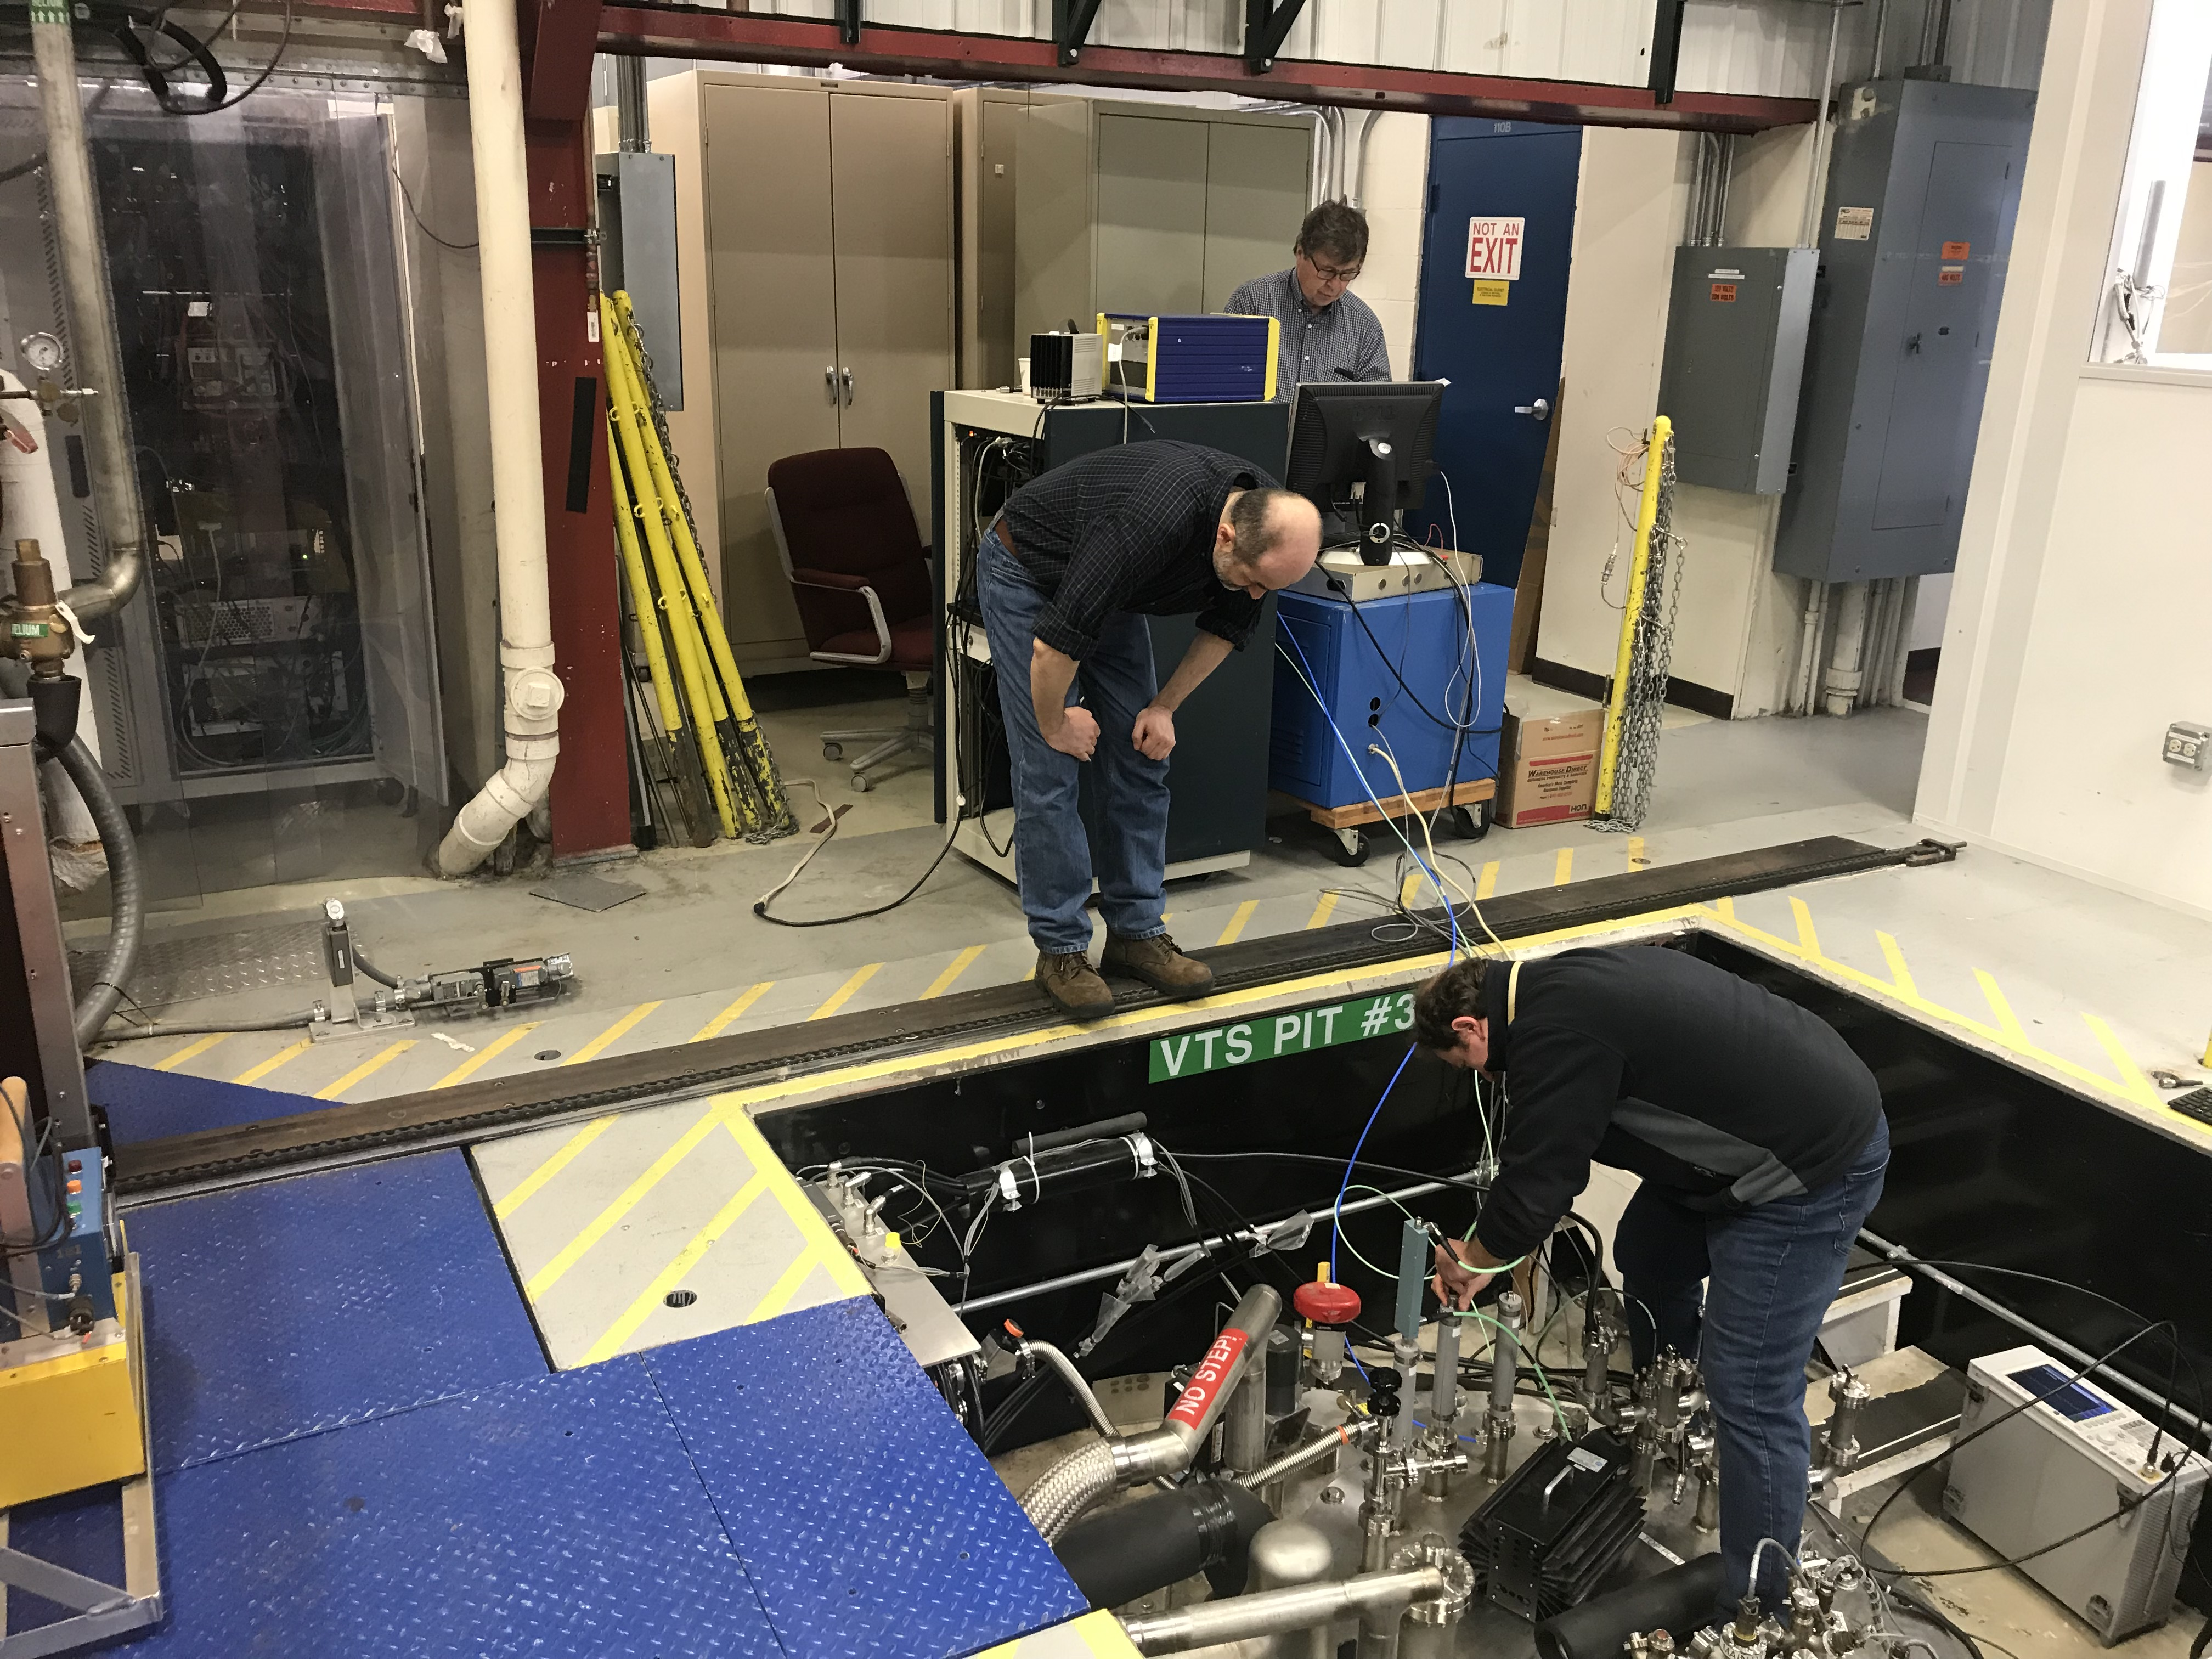
2019 Run pictures

Slide 17
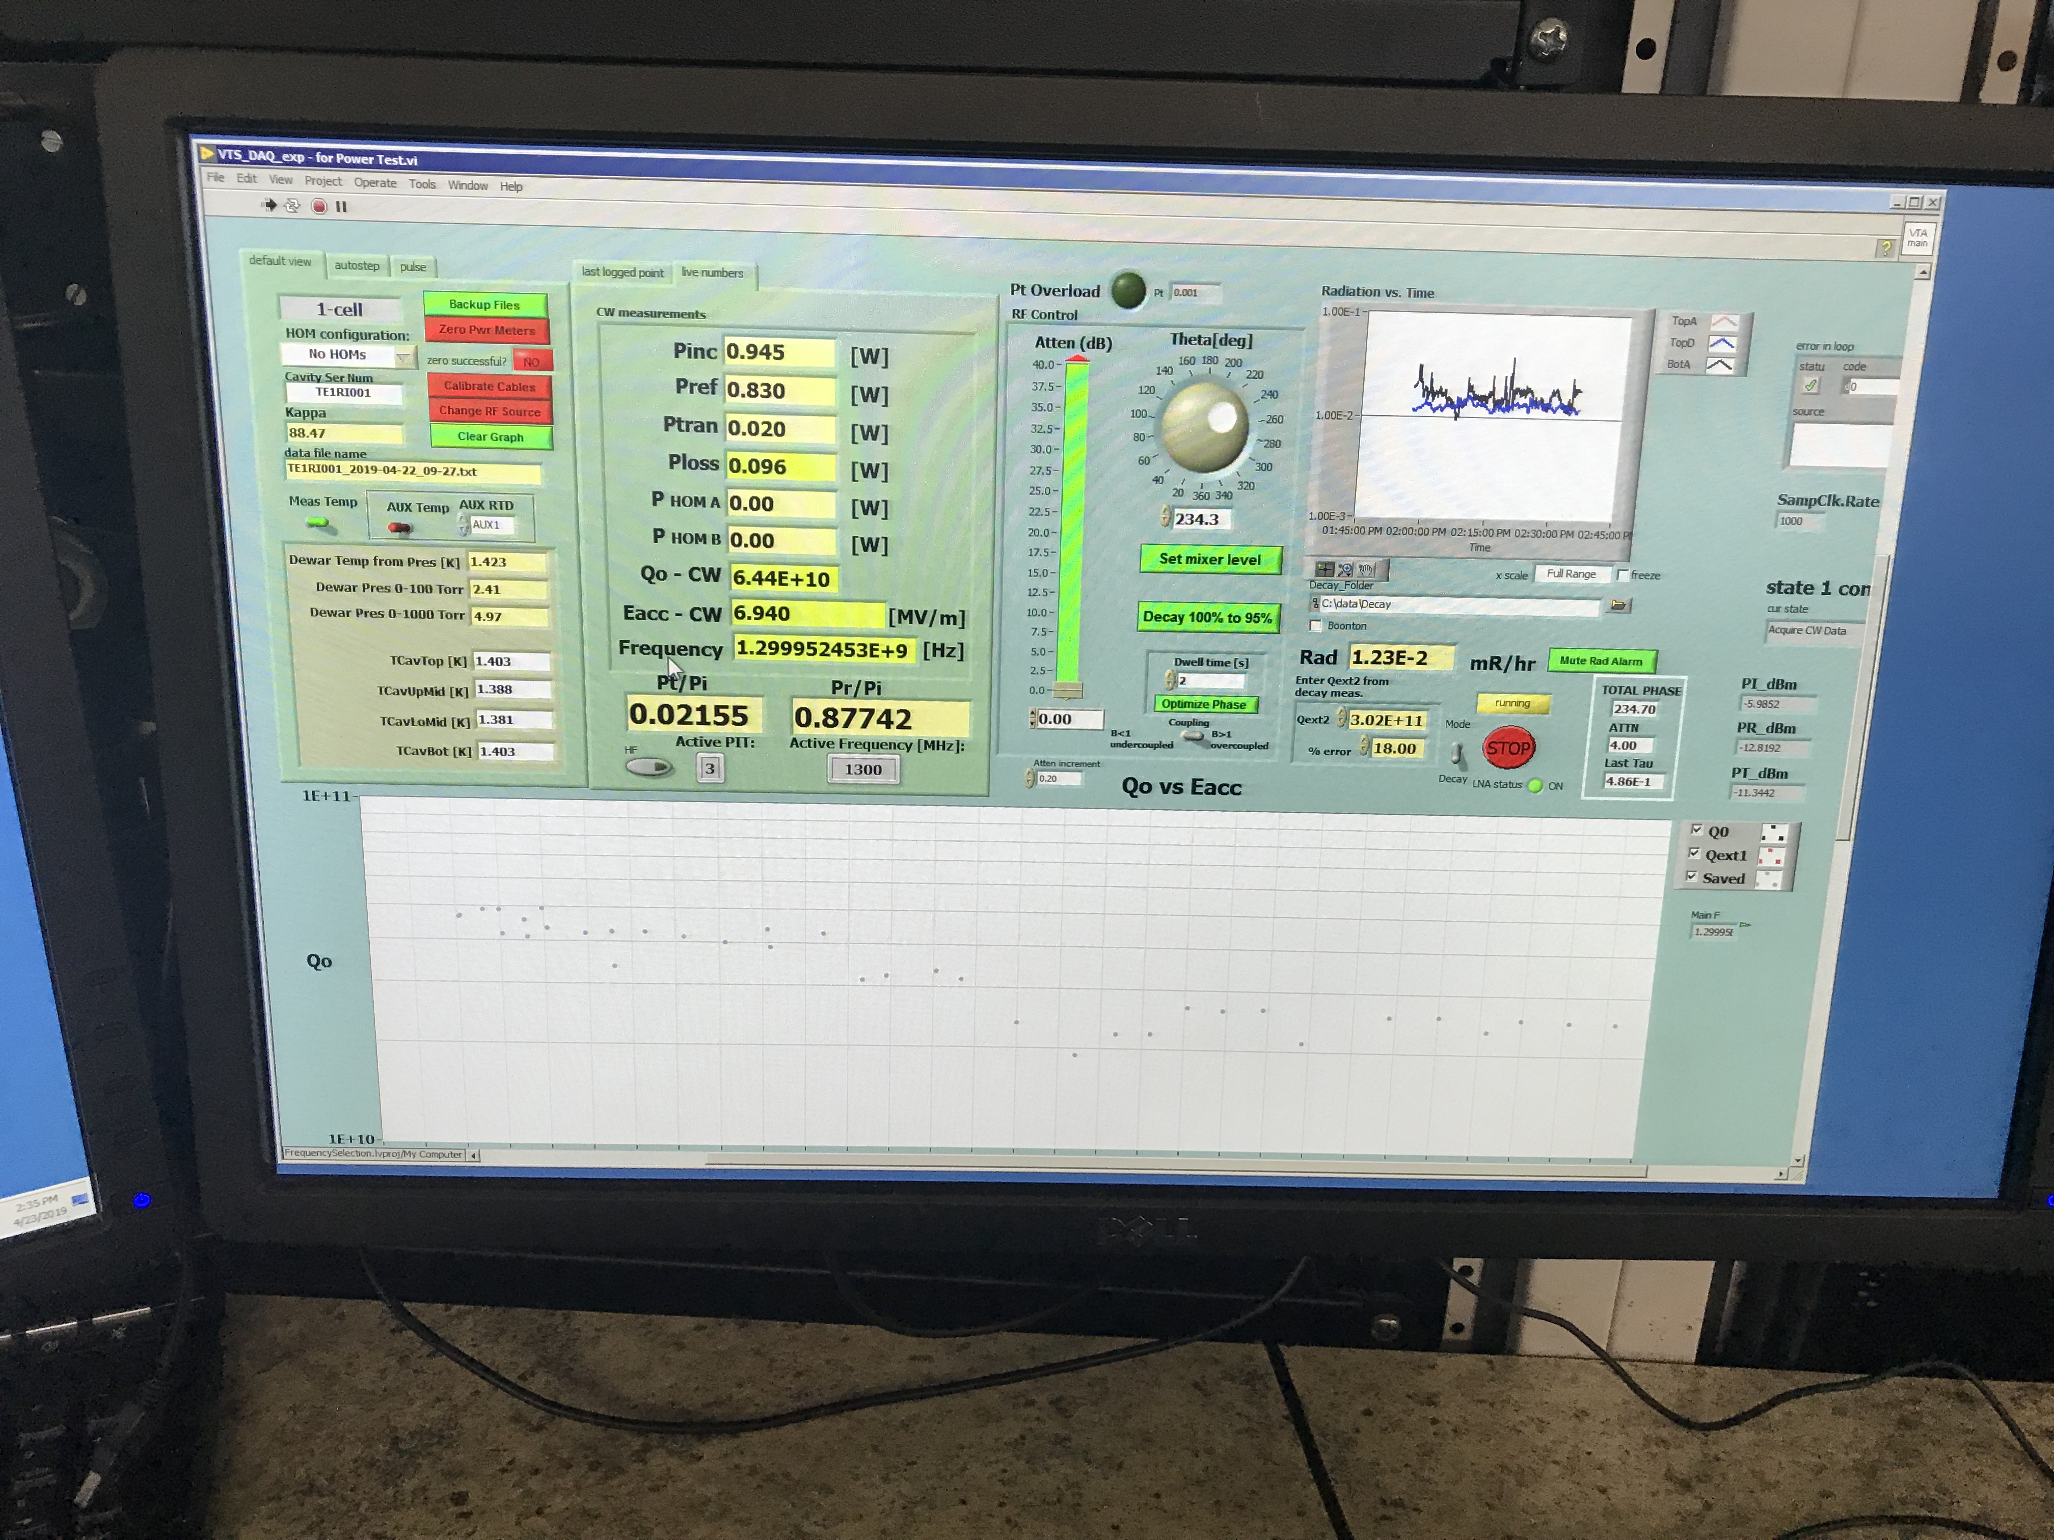
Cavity frequency matching – Step 1
~ 6 MV/m
From now on, most measurement are shown in dBm (dB 10log(x), dBm=10log(x/mW).) Note that we are always in dB-space, 3dB = factor of 2 in linear space.
Transmitter
(with PLL)
P_{t}^{TR}
Tunable size/frequency
RF
source
~
-20 dB
Receiver
P_{t}^{REC}
On spectrum analyzer
PLL (phase lock loop)

Slide 18
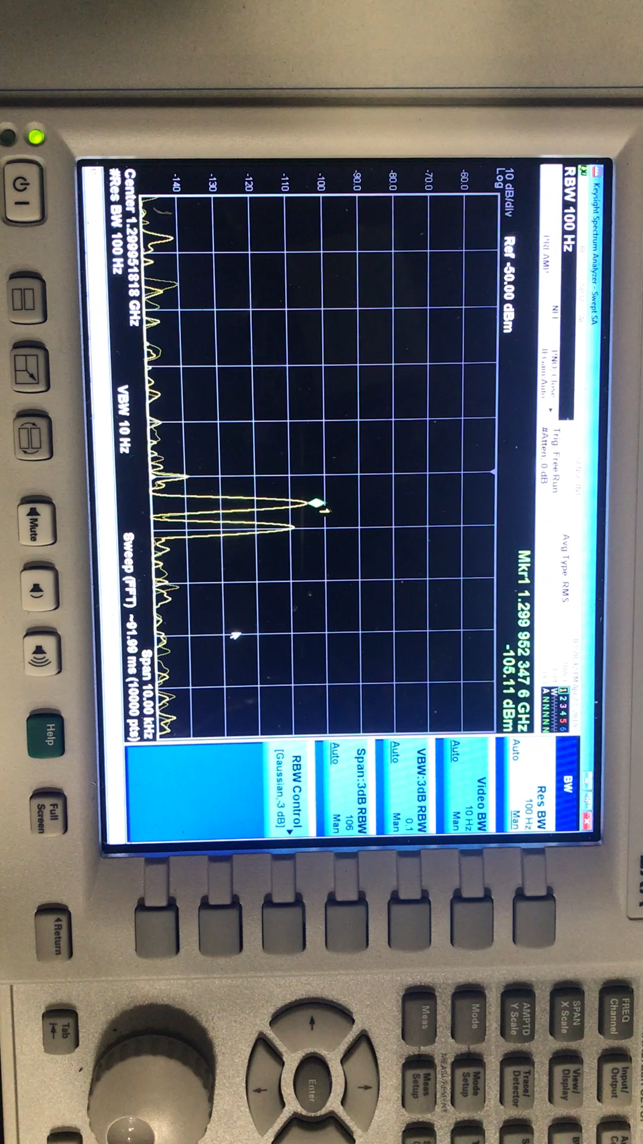
Frequency matching emitter/receiver

Slide 19
Dark Photon search! – (Step 2)
~ 6 MV/m
Transmitter
(with PLL)
P_{t}^{TR}
Tunable size/frequency
RF
source
~
Receiver
P_{t}^{REC}
On spectrum analyzer

Slide 20
Cross-talk check - Step 3
Transmitter
(PLL off)
P_{t}^{TR}
Tunable size/frequency
RF
source
~
Receiver
P_{t}^{REC}

Slide 21
Back to dark photon search - Step 4 = Step 2
~ 6 MV/m
Transmitter
(with PLL)
P_{t}^{TR}
Tunable size/frequency
RF
source
~
Receiver
P_{t}^{REC}
On spectrum analyzer

Slide 22
Back to Step 5 = Step 1 – all in tune
~ 6 MV/m
Transmitter
(with PLL)
P_{t}^{TR}
Tunable size/frequency
RF
source
~
-20 dB
Receiver
P_{t}^{REC}
On spectrum analyzer

Slide 23
Step 6 = all detuned (transmitter by tuner)
Transmitter
(PLL off)
P_{t}^{TR}
Tunable size/frequency
RF
source
With -20 dB disconnected
~
-20 dB
Receiver
On spectrum analyzer
P_{t}^{REC}

Slide 24
Measurements and Results

Slide 25
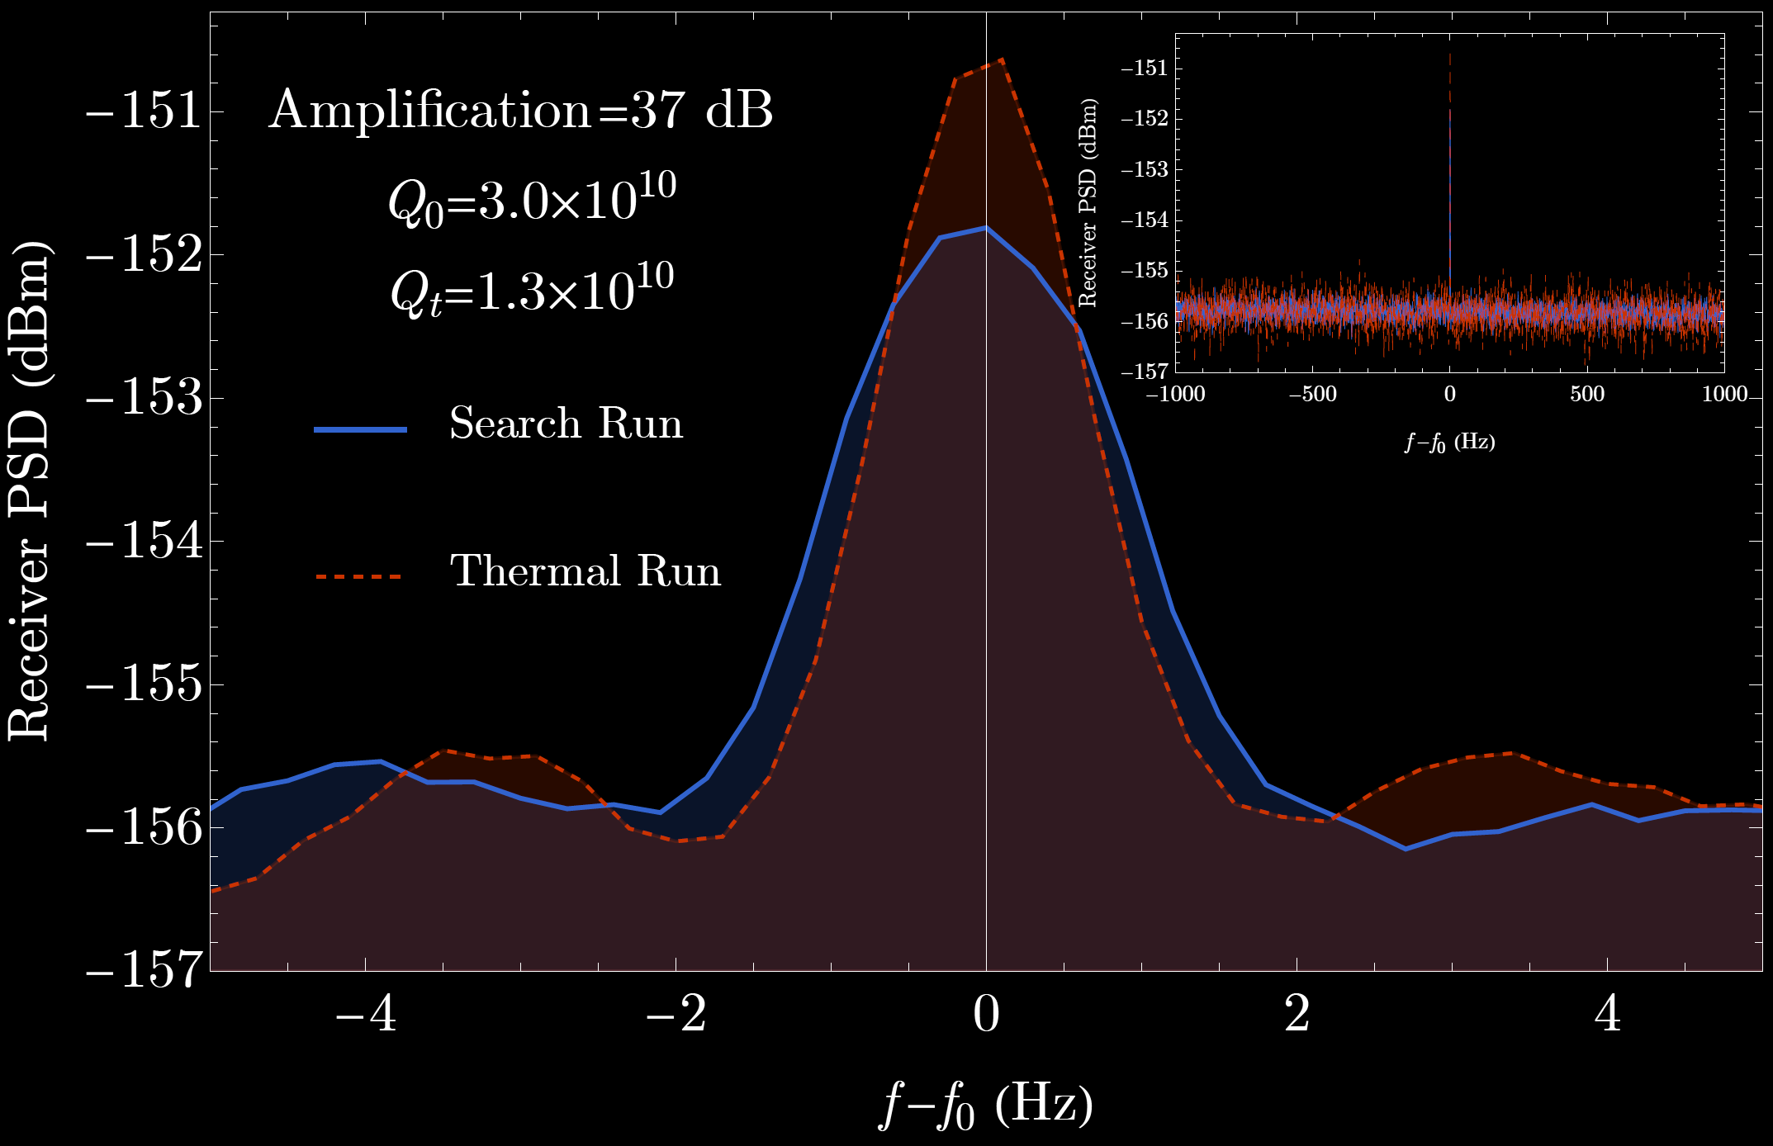
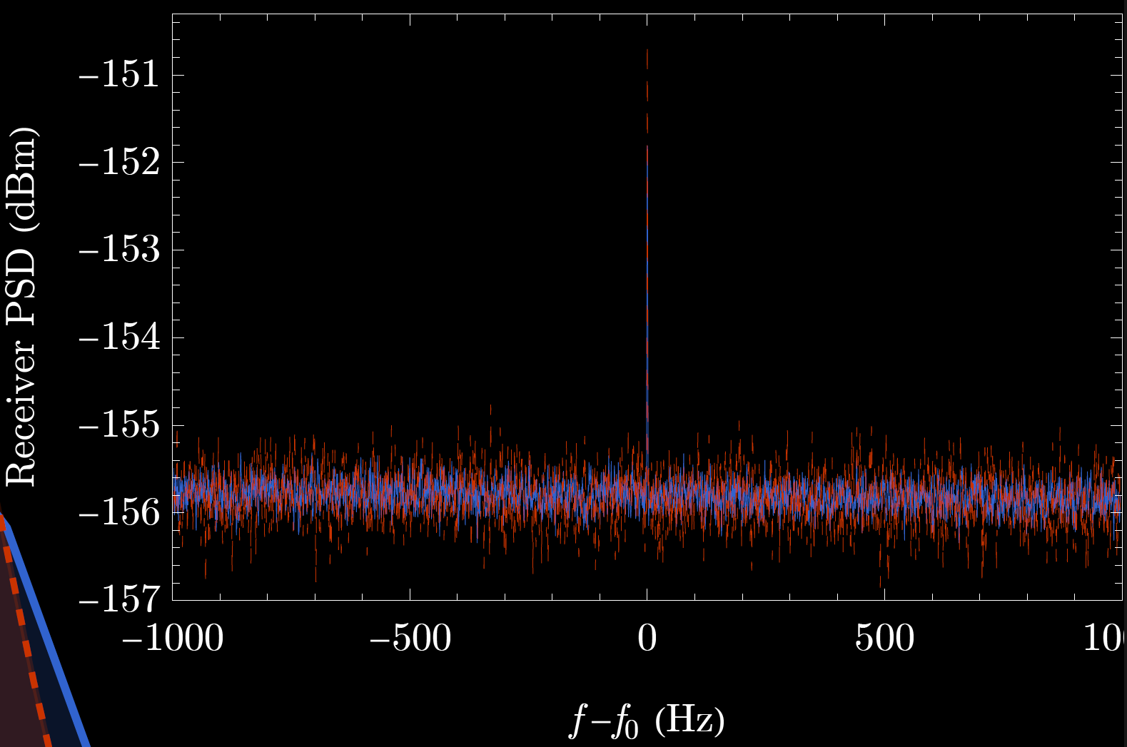


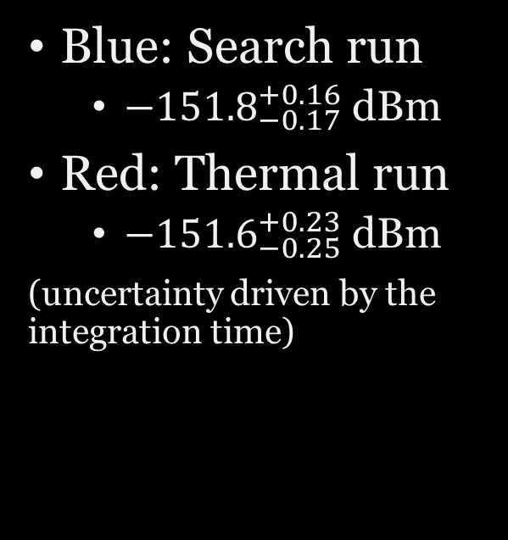
Thermal run v.s. Search run
Blue: Search run
$−{151.8}_{−0.17}^{+0.16}$ dBm
Red: Thermal run
$−{151.6}_{−0.25}^{+0.23}$ dBm
(uncertainty driven by the integration time)
$f_{0}≃1.3$ GHz
Window size $\sim {10}^{−6}$
We just counted photons in this window.
$f_{0}≃1.3$ GHz
Window size $\sim {10}^{−9}$

Slide 26
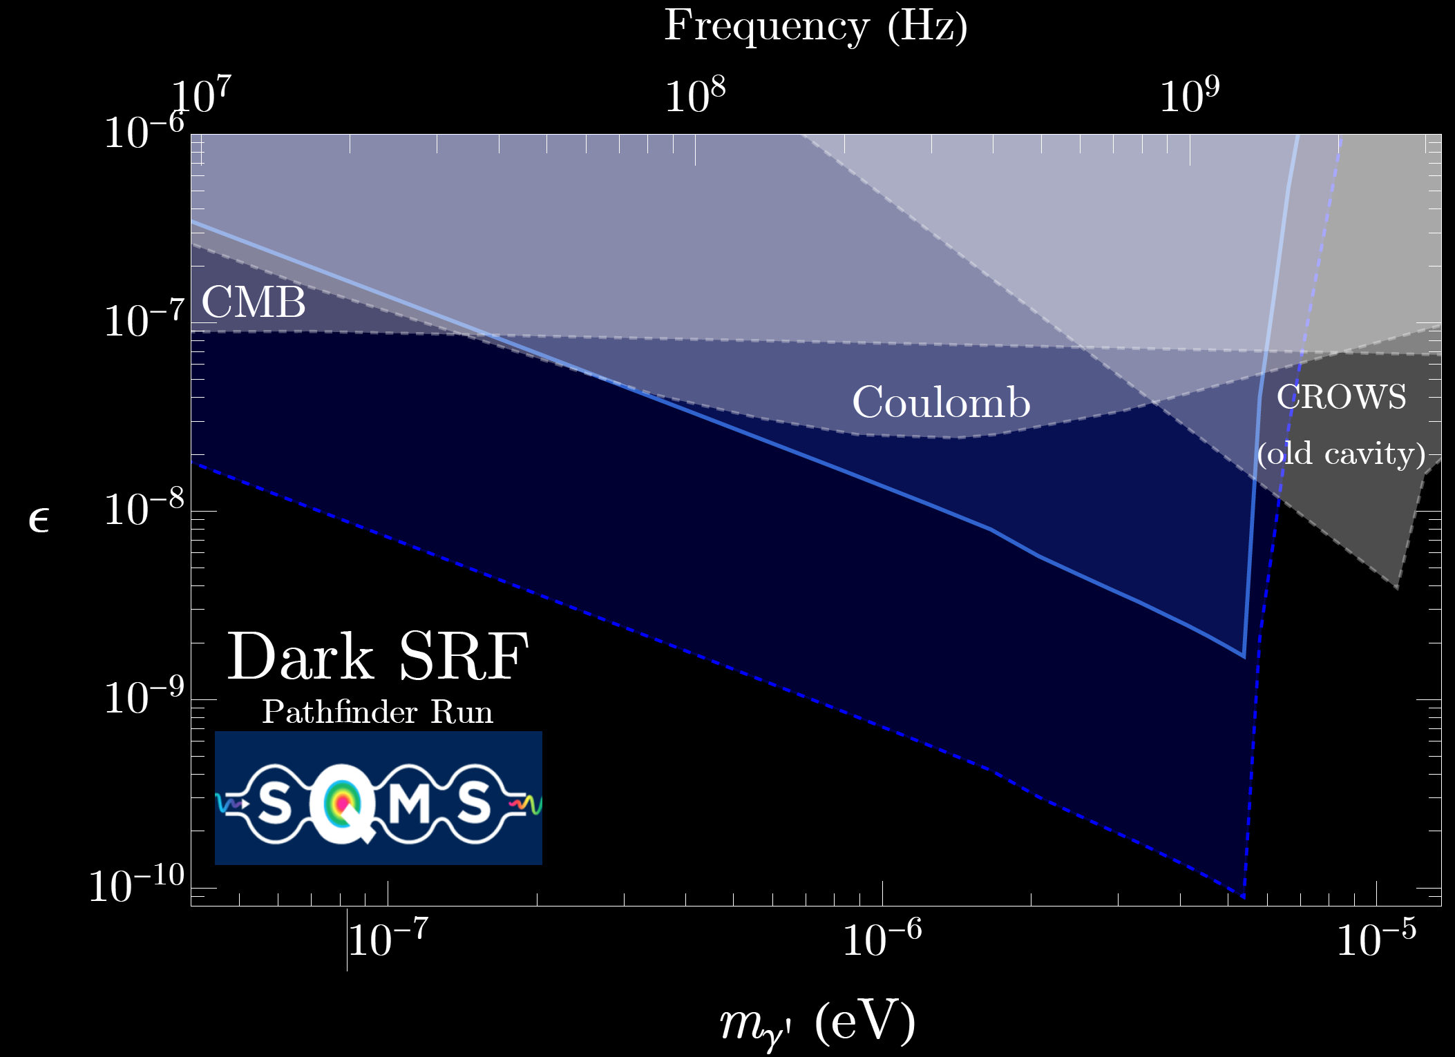
Exciting New Coverage
Our pathfinder run results already explore new territory in such a log-log space!
We’ve learned a lot about the system and published our first results and been developing many new future directions (as planned).
If one uses the equations and plugs in the numbers, we should be here…

Slide 27
High-Q not always a blessing

Slide 28
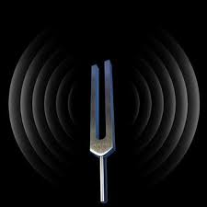
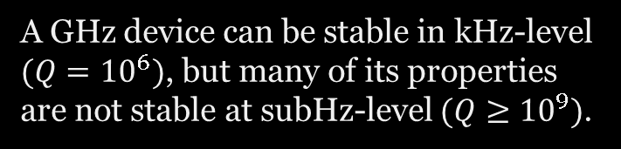

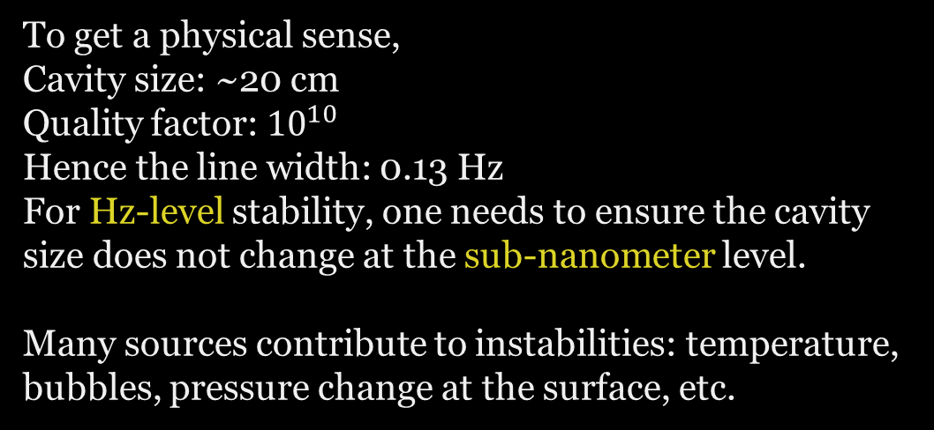
I lied (oversimplified) quite a bit:
High-Q is a double-sided sword
Our pathfinder result did not benefit as $Q^{2}$that we initially wanted
We are in a different limit that has not been explored before: $\frac{ω}{Q}≪δω$ (the sources I will highlight soon)
Post the end-of-2019 pathfinder search run, we had to perform many validations- and cross-check runs between 2020-2022
A GHz device can be stable in kHz-level $(Q={10}^{6})$, but many of its properties are not stable at subHz-level $(Q≥{10}^{9})$.
To get a physical sense,
Cavity size: ~20 cm
Quality factor: ${10}^{10}$
Hence the line width: 0.13 Hz
For Hz-level stability, one needs to ensure the cavity size does not change at the sub-nanometer level.
Many sources contribute to instabilities: temperature, bubbles, pressure change at the surface, etc.

Slide 29
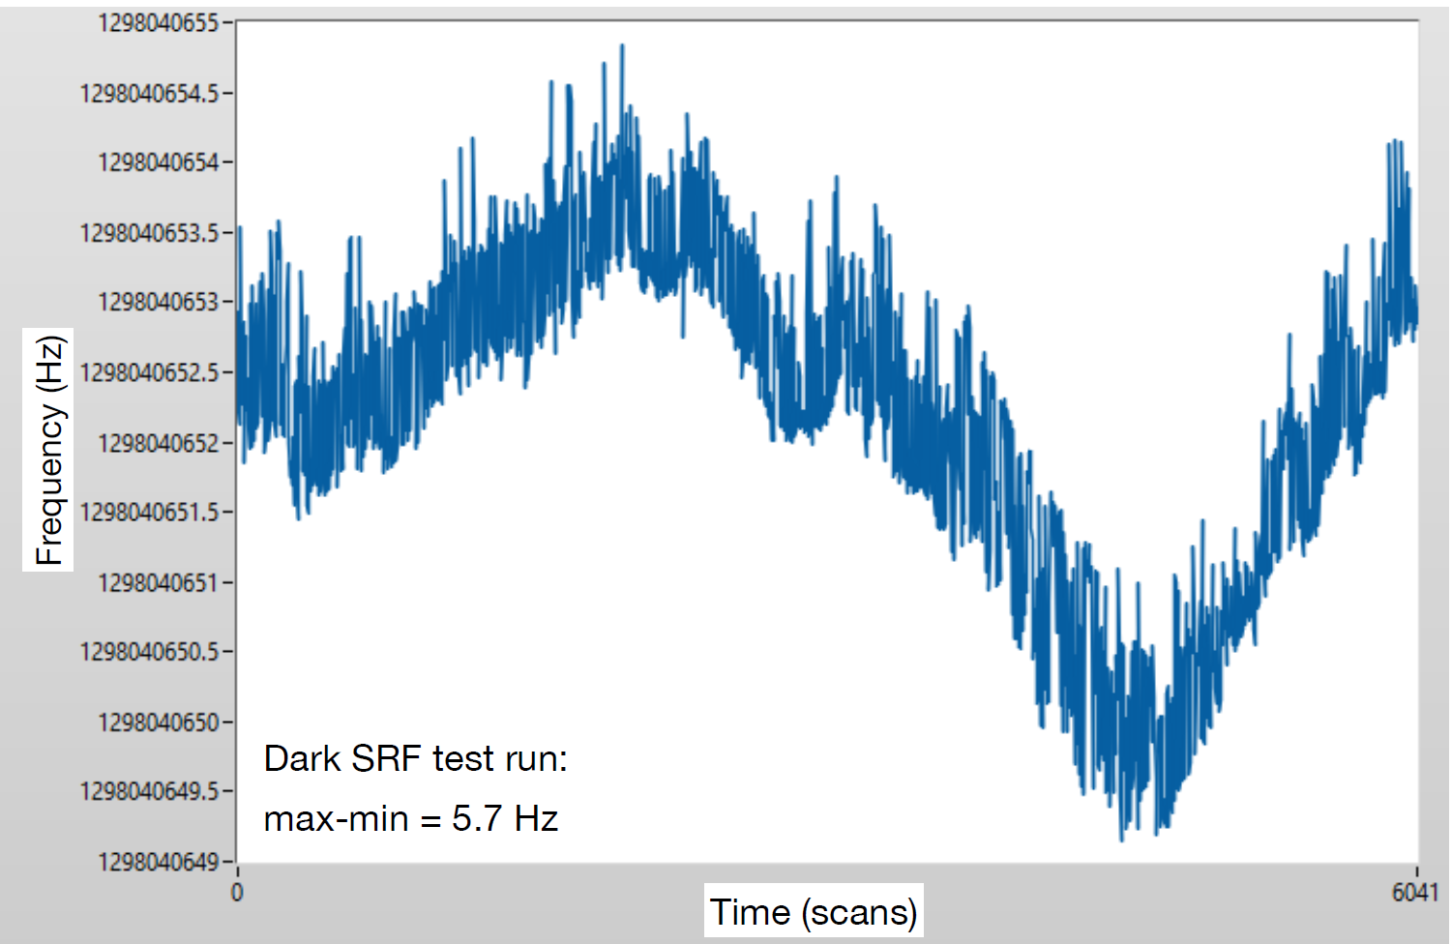
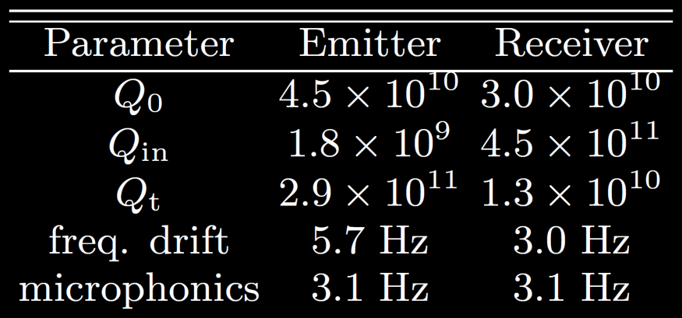
Emitter cavity frequency stability
Dedicated frequency stability runs, two effects:
Frequency drift
Microphonics
1Hz
Search run time: ~30mins
6Hz
100 mins

Slide 30
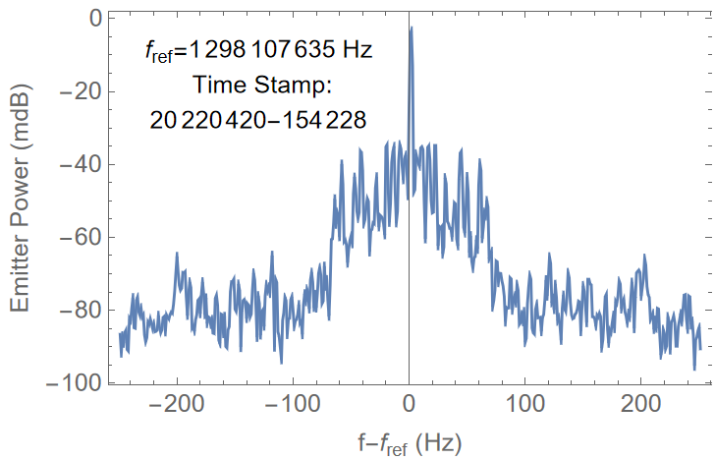
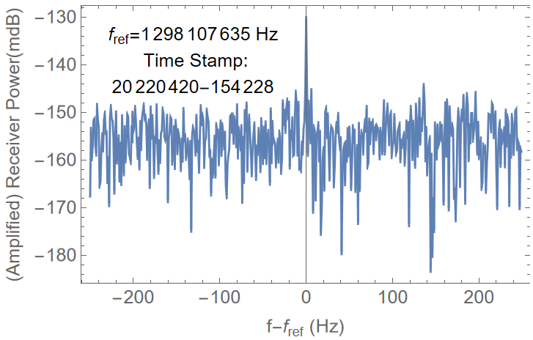
The PSD of the Emitter and Receiver at a given moment

Slide 31
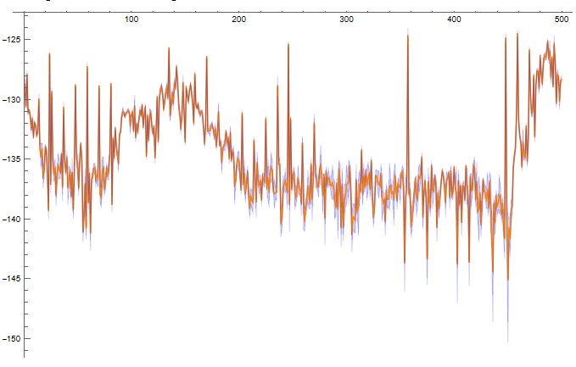
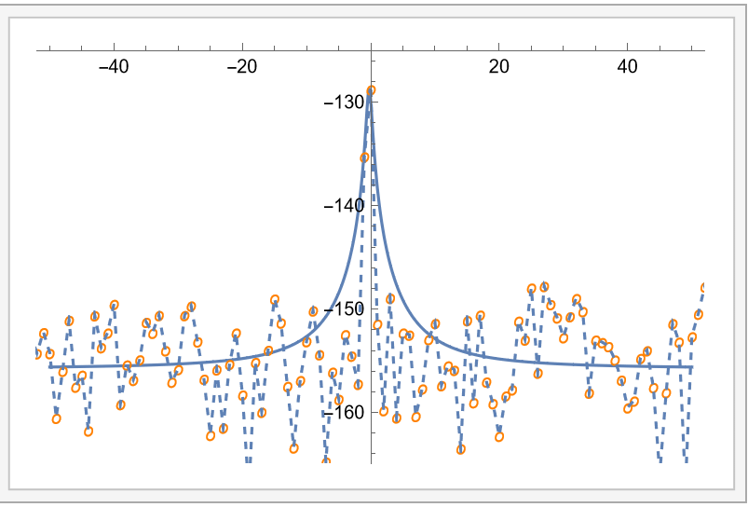
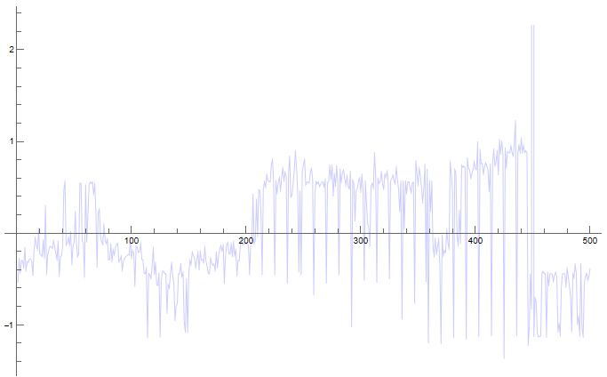
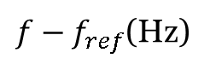
Data Visualization and checks (receiver fit; validation run 19, 2022)
$f−f_{ref}$(Hz)
dBm
Power
Frequency Stability

Slide 32
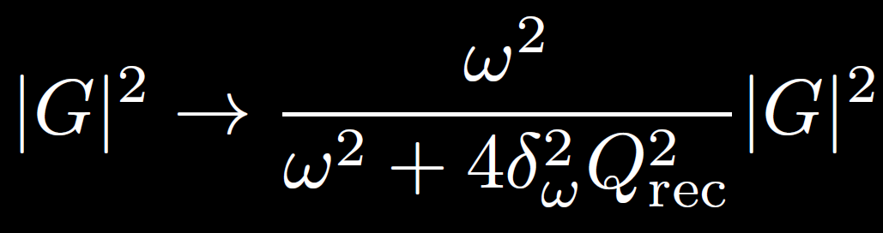
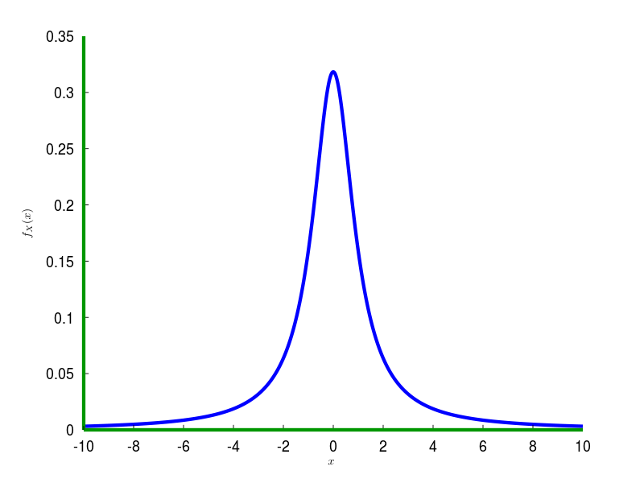
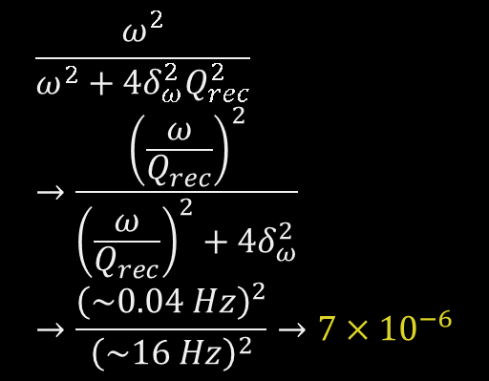
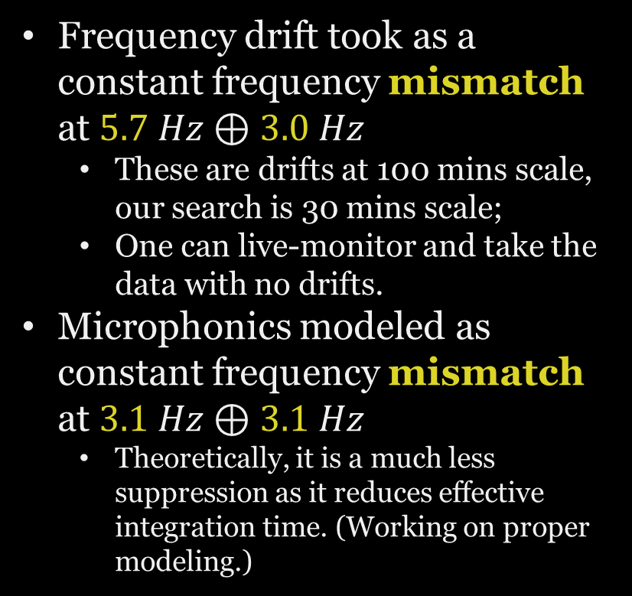
We presented a very conservative limit
Frequency drift took as a constant frequency mismatch at $5.7 Hz⊕3.0 Hz$
These are drifts at 100 mins scale, our search is 30 mins scale;
One can live-monitor and take the data with no drifts.
Microphonics modeled as constant frequency mismatch at $3.1 Hz⊕3.1 Hz$
Theoretically, it is a much less suppression as it reduces effective integration time. (Working on proper modeling.)
$$\frac{ω^{2}}{ω^{2}+4δ_{ω}^{2}Q_{rec}^{2}}→\frac{{\left(\frac{ω}{Q_{rec}}\right)}^{2}}{{\left(\frac{ω}{Q_{rec}}\right)}^{2}+4δ_{ω}^{2}}→\frac{{\left(\sim 0.04 Hz\right)}^{2}}{{\left(\sim 16 Hz\right)}^{2}}→7×{10}^{−6}$$
Essentially, modeled as searching off-resonance.

Slide 33

Near (or far?) Future
Improving noise isolation and control into few photon limits;
Improve Q (seems require careful discussion)
Phase-sensitive readout
Off-the-shelf cavities →better designed and treated ones
New design
New search protocol
SQMS Snowmass contribution:
2203.12714

Slide 34

Other and related activities
Dark photon DM search;
Axion LSW validation and search;
Single cavity design
Double cavity multi-mode design
Double cavity plus conversion region design
Axion DM search;
Gravity Wave validation and search;
Millicharged particle search;
Photon mass constraints;
…
SQMS team: 2208.03183
See many recent studies, and also partial summaries in SQMS SRF paper: 2203.12714

Slide 35
Outlook
Fun journey to arrive at a first result using SRF cavities for HEP searches in the Dark SRF pathfinder run.
Covered new parameter regions in the log-log space;
Learnt & learning to handle ultrahigh Q opportunities;
Establishing and developing schemes for robust tests;
An active program ahead:
Many planned steps improve the results significantly;
Many possible theory research directions to improve the results & treatments (interested parties highly welcome!);
Many “adjacent” exploration and searches possible;
Thank you!
& the fantastic Dark SRF team!

Slide 36




Equations
$P_{receiver}=ε^{4}{\left(\frac{m_{γ^{′}}}{ω}\right)}^{4}{\left|G\right|}^{2}ω Q_{receiver} U_{emitter}$
$P_{receiver}=ε^{4}{\left(\frac{m_{γ^{′}}}{ω}\right)}^{4}{\left|G\right|}^{2}ω Q_{receiver} Q_{emitter} P_{emitter}$

Slide 37




What appendix 13 activity and/or WBS deliverable do these activities address?
Implementing QIS and SC technologies to search for new fundamental physics which has been beyond reach until now
Dark photon
Photon-photon scattering
Axion

Slide 38



Dark Photon LSW
Axion Dark Matter
Axion
Dark Photon Dark Matter
Notes:
Add photo of team (can we do a photo all together on Monday?)

Slide 39



10T DR
Axion Dark Matter

Slide 40
What have we achieved to date?
Appendix 13 major activity & deliverable:
1.3GHz DarkSRF in VTS
Brief description of experiment conducted
First proof of principle LSW search for Dark photon with SC ultrahigh Q cavities
Major practical and scientific accomplishment to date:
Demonstrated unprecedented sensitivity to dark photon using two SRF 1.3GHz cavities. Motivates phase two of DarkSRF: 2.6GHz cavities in DR with receiver at mK.
Next proposed steps:
2.6GHz DarkSRF in DR
Improve frequency stabilization
Phase readout
Improve cavity design and searches

Slide 41
Thank you!
& Thanks to the fantastic Dark SRF team!

Slide 42

Data Visualization and checks (emitter fit; run 19)

Slide 43


Slide 44

About basis and calculation
For the basic Lagrangian, where only kinetic mixing exists in the gauge basis (no mass mixing), often the easiest basis is to rotate photon field such that the rotated photon field remain massless and the rotated dark photon field picks up an $ε$-suppressed coupling to charged current. Under such basis, the LSW experiments follow the following narrative (remove the word “rotated” in the following since we are in a new basis already):
One power up the emitter cavity with photons (achievable by various setup; instead, one can also power up by the electron motions, have to think how to describe);
The photon field meets the superconducting cavity wall and satisfies the E&M boundary condition that there are induced motions at fixed frequency;
These electron motions has wave-function overlap with the dark photon field through the $ε$-suppressed coupling and induces a dark photon field. The induced dark photon field, since it has a mass, has its time evolution fixed at $ω$;
Every oscillating electron is a point source of dark photon field, with a pattern in directions due to different combination of transverse and longitudinal modes;
At the receiver side, the inverse take place.
The above logic is flawed, need to think about it more.

Slide 45

Another basis
Another basis choice, interaction basis, one rotate dark photon field, such that the photon pick up a small mass mixing dark photon field $εm_{γ}^{′}$ and an $ε$-suppressed coupling with the dark charged current (which has no effect since we can decide to decouple the dark fermions). In this basis:
Emitter

Slide 46
For a dark photon exactly on resonance

Slide 47


Slide 48
One can always get quick and dirty results and pretend they are good. And show aggressive projections to dominant the field. Maybe I shouldn’t be so conservative?

